Slide 1
History of computing - 2

Slide 2
Picking up where we left off
The commercial computer industry had been born
Computers are just starting to switch over to transistors
Computers still mostly transmitted data on punched cards, and most computers have magnetic tape storage
Programming languages are starting to become common, but operating systems have not yet been developed

Slide 3
Iron age

Slide 4
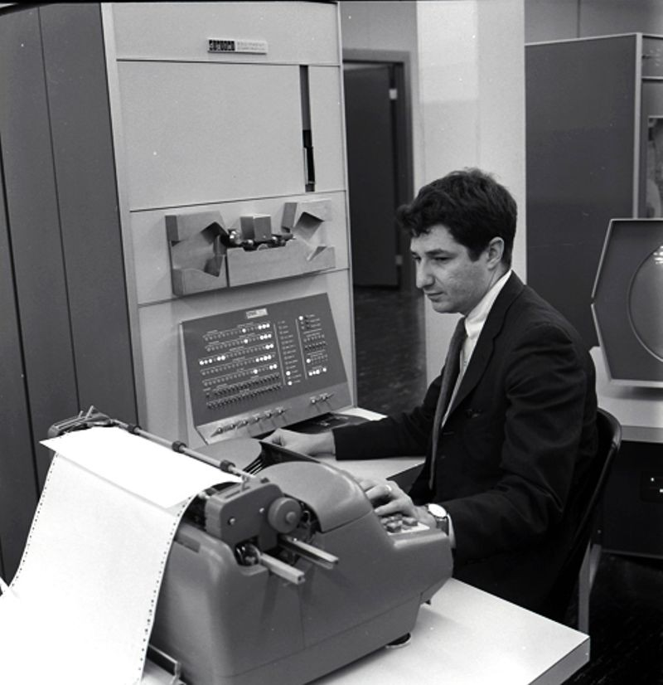
PDP-1
One computer marked the transition from the bronze age to the iron age
The PDP-1 was the first of a new class of computer- the minicomputer
Unlike the computers that came before it, this computer did not take up an entire room
It also had a graphical display, and the first popular video game (asteroids)

Slide 5
What did this show?
Computers were becoming more common and standardized, and a classification system was needed:
Supercomputers – the biggest computers, with a focus on raw number crunching capacity. Used for scientific and mathematical problems
Mainframes – big computers, usually operating in batch mode, with a focous on business uses
Minicomputers – Smaller computers, usually running real-time programs. Designed for use by one person or a department
Need for computers was greatly increasing

Slide 6
COBOL
3 major events happened in 1961, the first of these was the release of COBOL
COBOL stood for Common Business Oriented Language, and it was the first language that was designed for use by non-programmers
It had a highly wordy syntax, designed to resemble English
It was disliked by algorithmic/systems/scientific programmers, but it became highly popular among buissnesspeople

Slide 7
Language categorization
Cobol also lead to the breakdown of computer languages into three main types
Systems languages – languages designed to program the basic systems and services in the computer, like operating systems and drivers
Scientific languages – languages designed to do scientific or mathematical number crunching work
Business languages – languages designed to build programs used for corporate and financial work
These categories still exist, although the lines have become a lot more blurred in the intervening years
These categories are also not mutually exclusive

Slide 8
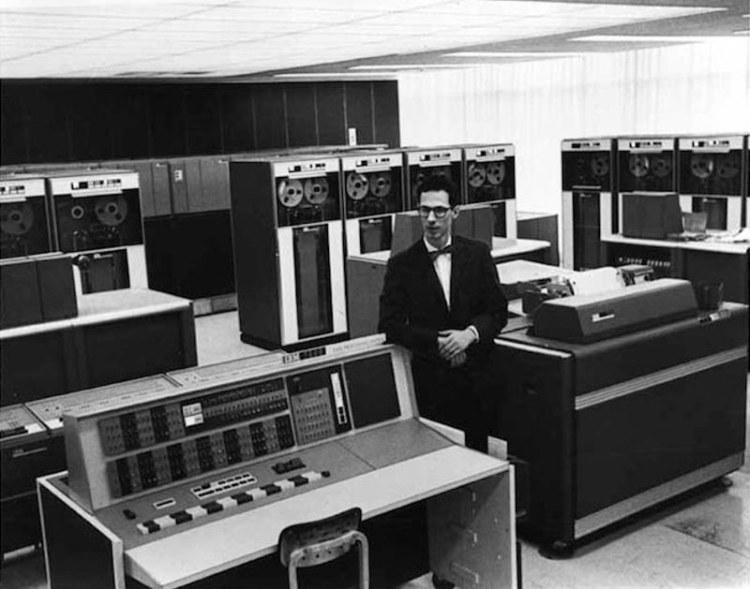
CTSS
At MIT, the Compatible Time Sharing System was developed
This system was the first true multi-programmed, multi-user, online computer
Users at terminals could type in commands to the system which would execute them one at a time, balancing all the users in the system
This was also the first example of an operating system in the modern understanding of the word

Slide 9
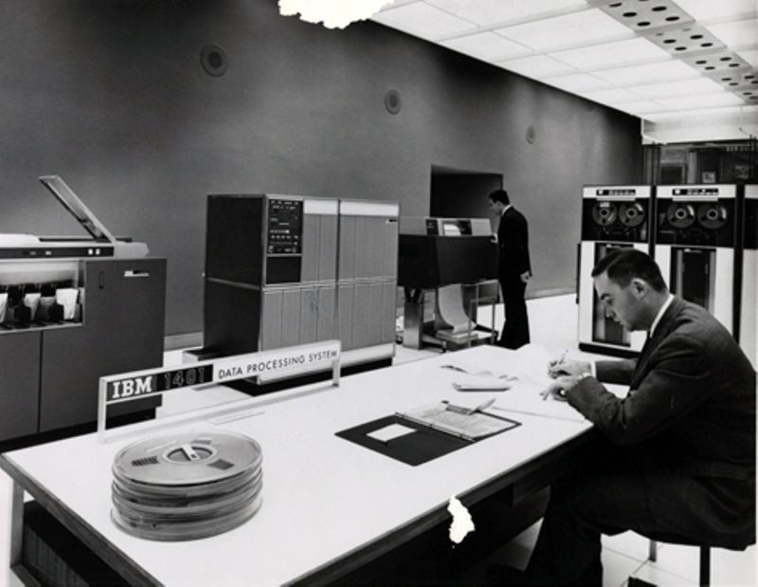
The IBM 1401
The IBM 1401 was a major advance not in technology, but in availability
The 1401 (which ran without an opening system, strictly from punched cards) was cheap enough that it could be deployed in smaller companies that could not afford a cutting edge computer
This strategy was one of the main things that secured IBM’s dominance of the industry. By the mid 1960s, half of all computers were 1401s

Slide 10

Daisy Bell
In 1961, the first entirely computer generated song and voice was created. Take a listen:

Slide 11
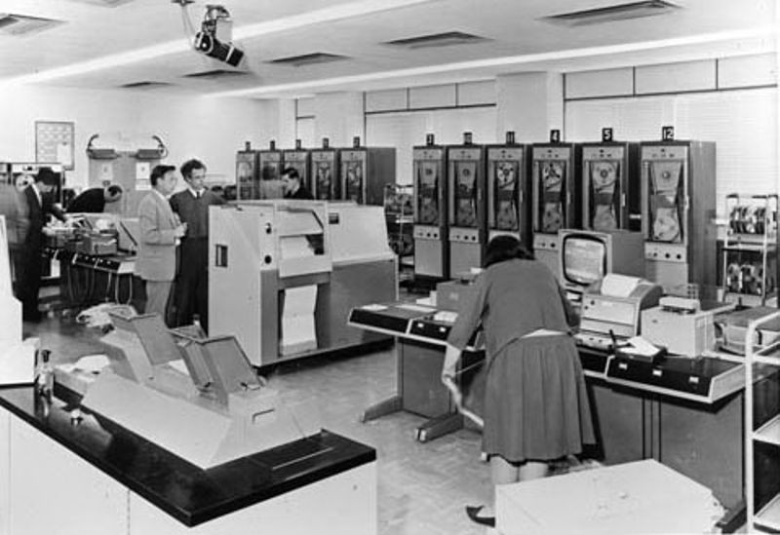
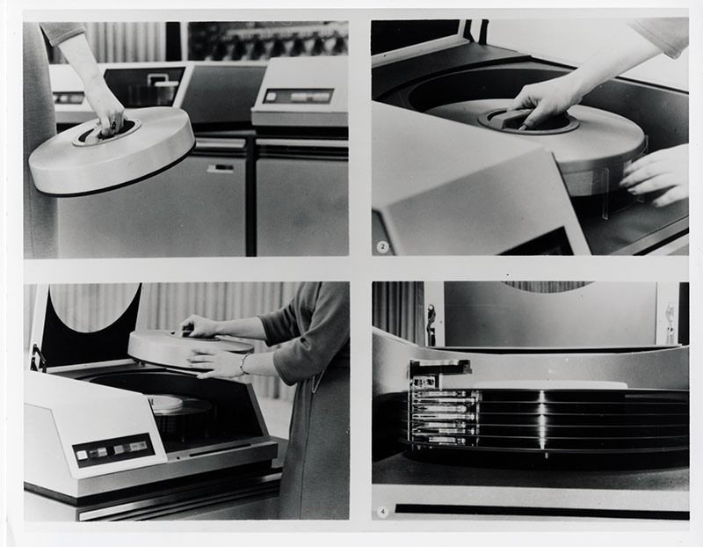
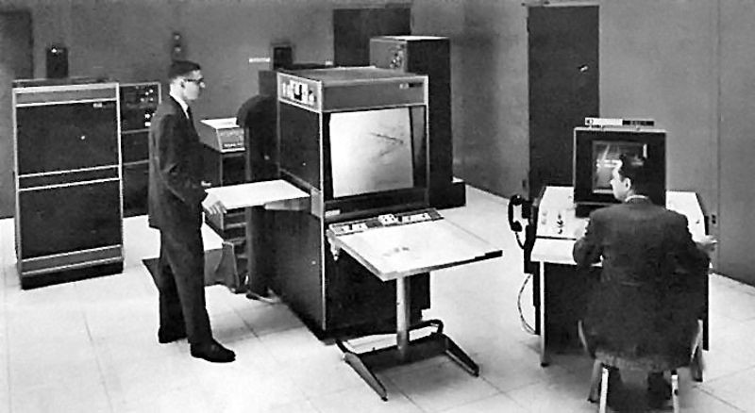
Assorted innovations
In England, the atlas computer was released, which was the first in the world to use virtual memory. Because of this, some consider it to be the first computer with a true modern operating system
In 1962 was the IBM 1311 disk drive, which was the first widely deployed hard drive
In 1963, the DAC-1 program was released, as the first commercial computer graphics program

Slide 12
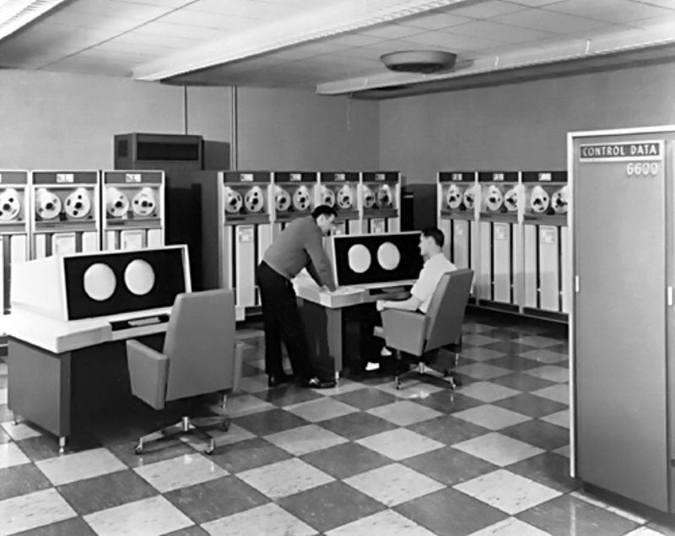
CDC 6600
The CDC 6600 was the first ever supercomputer
It was optimized for high-speed scientific computing, with quad graphical outputs and a processor speed that was 3x faster than anything else at the time
It was also the first computer with an accelerator, or additional processor that is designed to increase the speed of the main processor on specific workloads
It was also the first design by Seymour Cray, who would dominate this industry until his death

Slide 13
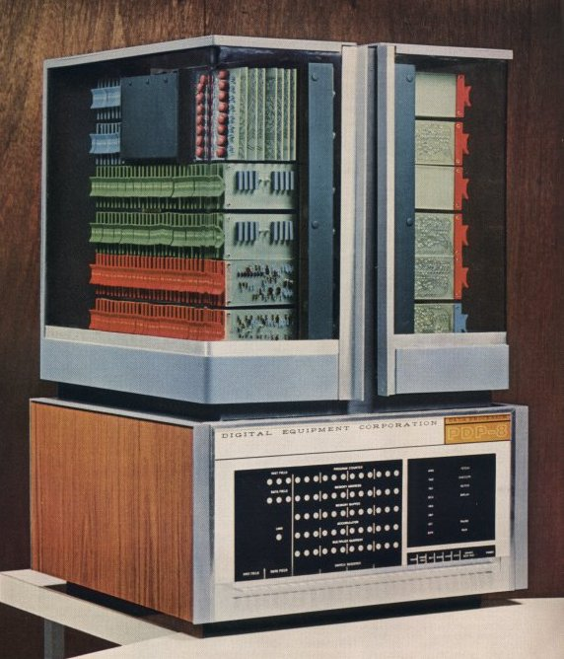
PDP-8
Although it was not the first minicomputer, it was the first one that was a wide-scale commercial success.
It was small enough to be man-portable, and very successful with applications that did not need a full mainframe
Think science labs, machinery control, individual users, and departmental systems

Slide 14
The IBM double whammy
In mid 1964, IBM released two MAJOR advancements that would change everything.
These were the IBM system 360 and the SABRE system

Slide 15
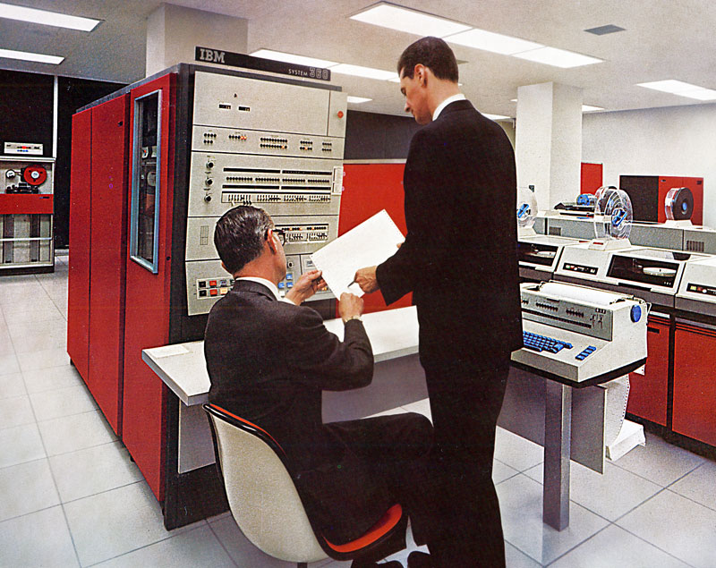
The IBM System 360
The 360 perhaps the most influential system ever made. This system was the first modern computer, and the line that it stared continues today. The three major 360 features were:
A common architecture across the entire line, with a promise of future backwards compatibility
An operating system made by the company which made the computer, and came standard with the system
INTEGRATED CIRCUTS!!!!

Slide 16

System 360 video

Slide 17
SABRE and CICS
Also in the same announcement as the 360, IBM announced SABRE
Remember how I said that the SAGE system would be really important?
The work that was done on SAGE was later further developed and commercialized by American Airlines and IBM in a joint venture. The result was SABRE
Not only was it the first time there was a fully-networked, time sharing system was scaled up to the national level, but it was the first online, real-time transaction monitor. (Think amazon)
IBM would later expand this into CICS and IMS, systems which are still in use today
The move from batch processing to online transaction processing with a batch supplement was one of the biggest changes throughout the 60s and 70s

Slide 18
The mother of all demos
In 1968, almost every advance that we would see in the 70s was demoed by ARPA
In this hour and a half demo, the world was introduced to
Word processing
Collaborative editing
Word processing
Mice and graphical user interfaces
Video conferencing
Hyperlinks

Slide 19
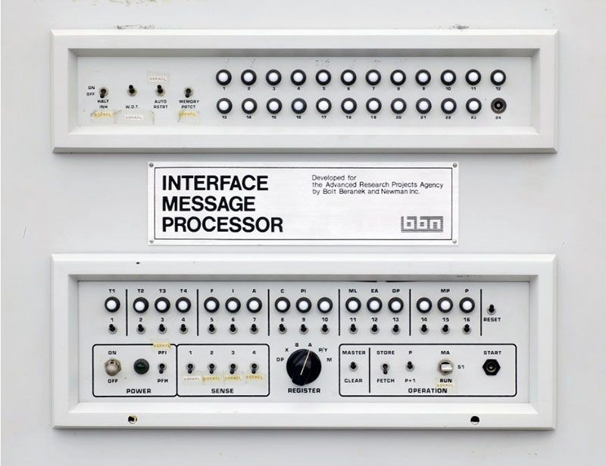
ARPANET
In 1969, the first network that interconnected not only terminals, but computers was brought online
This network was the direct predecessor of the internet
It was a major milestone for networking, data exchange, and humanity as a whole

Slide 20
UNIX
Also in 1969, the first version of Unix was released
Unix was perhaps the most influential operating system ever released
It had several killer features
Ease of use
Modular, independent design
HFS filesystem design
The shell and pipes
A time-sharing first and only design
But most importantly, it was quasi-free. This was massively important because it meant that it was not locked to one vendor’s computer, but could be translated to any computer
It was also designed for minicomputers primarily, which made the minicomputer platform much, much more powerful, and a very popular choice for programmers
It was also written in the C language, which would go on to become the standard systems language, and still is today

Slide 21
Iron age computers - 1
The iron age was categorized by innovation and transformation
At the start of this period, computers had vaccum tubes, no operating systems and ran exclusively in batch, while at the end on this period, they were based on integrated circuits and were running real-time transaction processing
Generally using an iron age computer meant that you would be using a mainframe, although the minicomputers of this period would only become more and more prevalent as time passed
You may have prepared your programs online with time sharing if you were lucky, or you may have submitted your jobs in batch

Slide 22
Iron age computers - 2
At least you had access to an operating system however, which would manage the hardware while you programmed
Some cutting-edge systems were also busy processing transactions in an online environment
The computers you were using still had ferrite core memory, but their processers were at the very least transistorized. Many computers had already been converted to integrated circuits

Slide 23
Industrial age

Slide 24
The first microprocessor
Marking the transition into “computers in everything” world that we live in today was the Intel 4004 microprocessor
This chip combined all of the separate ICs of a larger CPU into one chip, allowing the computer to not be cabinet sized
This would pave the way for the first personal computers some years later, but at the time would allow for computers to be put into more things, as embedded devices (computers programmed to be singe-purpose that do one thing based on fixed input)

Slide 25
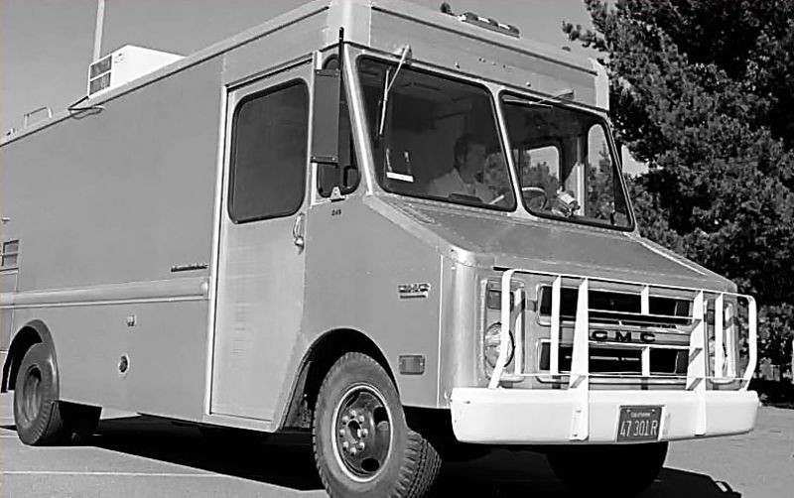
E-Mail
In the ARPAnet network that was discussed previously, over 50% of it’s traffic was a new communications medium: E-Mail
For the first time, people could communicate in groups or individually in real-time
Email was so popular it started driving the growth and deployment of the ARPAnet to new locations
Along with this, ARPAnet created the first mobile network by putting ARPAnet equipment in a van with a radio

Slide 26
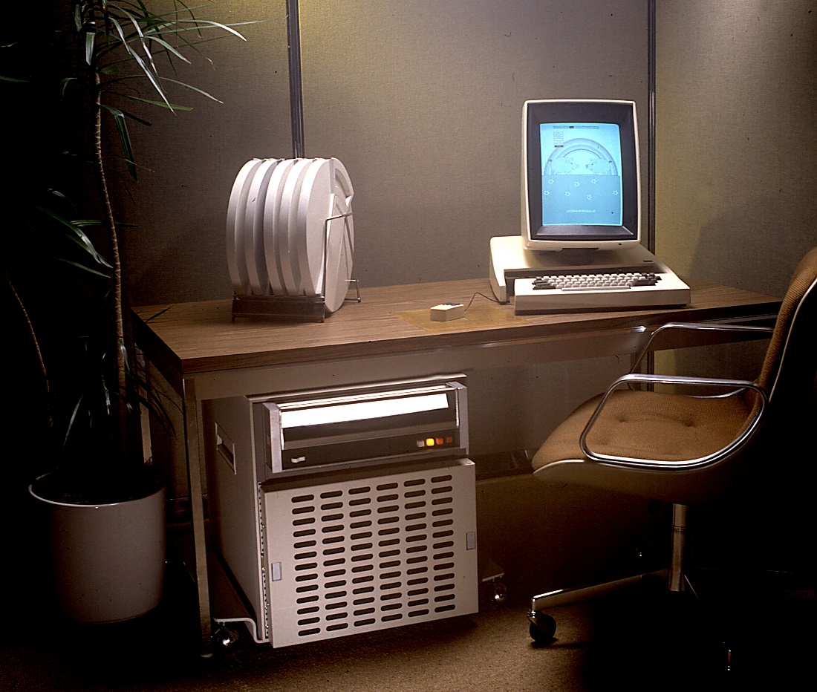
XEROX Alto
At the XEROX parc research lab, the Alto experimental office system was developed
This system, which was the first single-user graphical computer, implemented many of the features we know today
Mouse control
The desktop
Word processing
Local networks
Laser Printing
It also used the new ethernet standard, which would eventually go on to become the dominant networking standard even today
Every computer in the system sat at the desk of an individual user, was connected to every other computer, and could print, share files, and email

Slide 27
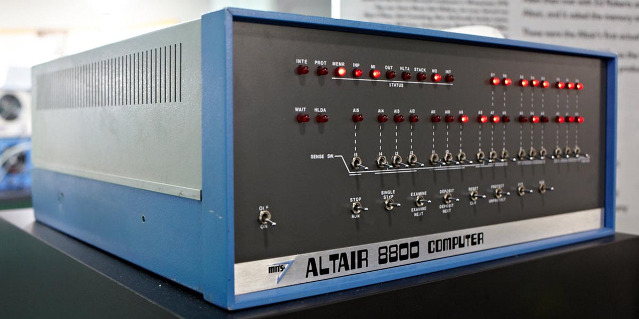
The first personal computer: The Altair 8800
While the 8800 was primitive, it was still a massive leap in computing technology for one reason:
It was the first commercially available personal computer
This computer would kick-start a revolution not only in computers generally, but also in the way people used computers
No longer would you have to share a big system, you could now keep your own

Slide 28
Redefining computer categories
The previous computer categories would get one more:
Supercomputers – the biggest computers, with a focus on raw number crunching capacity. Used for scientific and mathematical problems
Mainframes – big computers, usually operating in batch mode, with a focous on business uses
Minicomputers – Smaller computers, usually running real-time programs. Designed for use by one person or a department
Microcomputers – Computers designed for use by an induvial

Slide 29
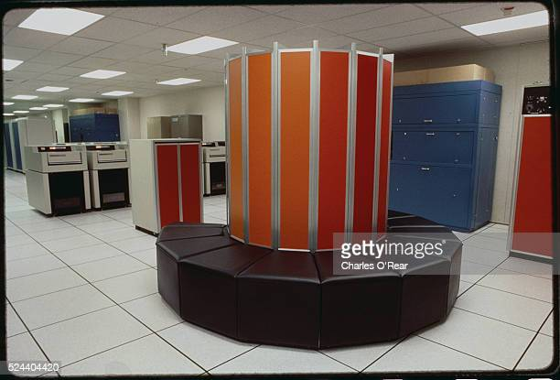
Cray-1
In 1976, Cray would release the cray 1, beating the previous computers he designed for control data by a factor of 2
A cray-series computer would be the fastest in the world for another 15 years

Slide 30
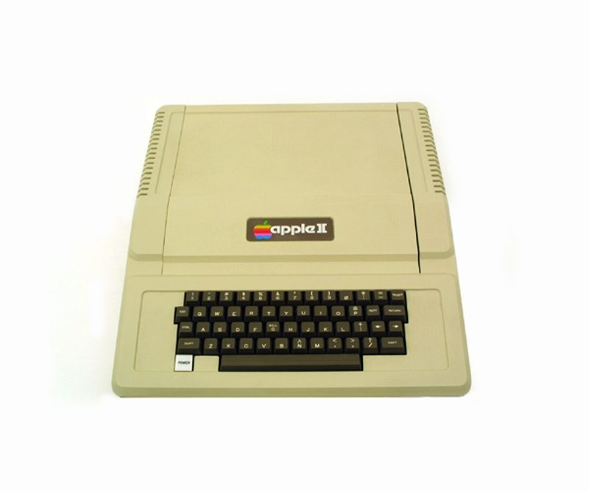
Apple 2
The apple 2, unlike its predecessors was sold as a complete package as opposed to a self-assembly kit
This made it the first breakout personal computer success, the Apple 2 brought computers to the desks of average Americans
While it was sold without an operating system (!), it was a major advance.

Slide 31
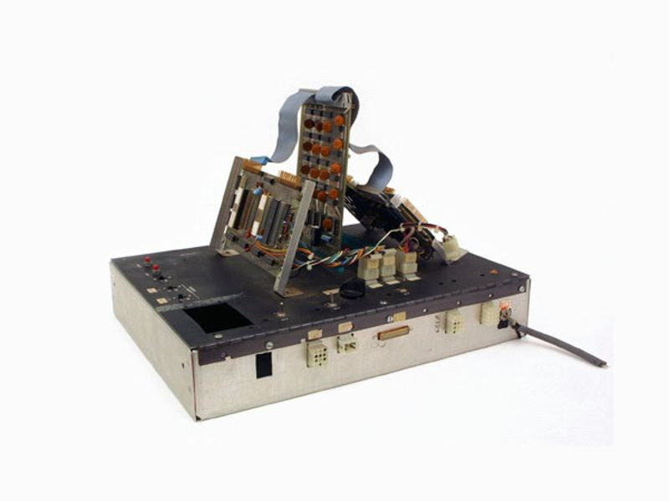
Atarti game console
Although it was a primitive, it was still a major advancement for bored kids all over the world
Rendering simple graphics, it played simple graphics based on a game stored on a cartage

Slide 32
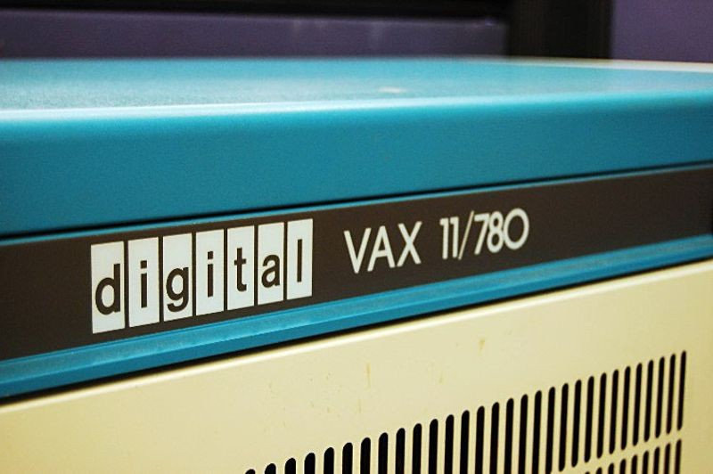
DEC VAX
The vax, building on the PDP-11 (the successor of the PDP-8), became the most popular minicomputer line ever made
With its high speeds, broad program range, expandability, and wide range of models, it would allow DEC to dominate the minicomputer market well into the 90s

Slide 33
VisiCalc
In 1978, VisiCalc, the first spreadsheet program was released
This program, running on the Apple 2, was a massive hit, instantly rocketing the Apple 2 into massive success. This program would convince many of the value of having a personal computer
It also would inspire decades of spreadsheet and office software
This innovation would also mark a major transition from the personal computer as a toy from nerds to a major tool for business folk

Slide 34
Industrial age computers - 1
In this time period, the biggest change was that computers got smaller
Throughout this period, there was relatively few new tech, but almost all of the tech previously invented became smaller, faster, and cheaper.
In the last period, we reviewed a massive stream of new tech, but all of this cutting edge tech was only available on the big mainframes and cost a fortune
By the end of this period, all of these features would be available on small(ish), cheap computers

Slide 35
Industrial age computers - 2
This was the first time where you were actually likely to run into a computer if you did not work in the industry
All of the cool stuff started over the last period would move out of the university and the lab
While you were unlikely to be using a CRT terminal at the beginning of this period, it was almost guaranteed by the end of it
Your computer would also have a relatively standardized operating system, and programming language toolkit

